Slide 1

MASTER’S DEGREE IN COMPUTER ENGINEERING
QUANTUM COMPUTING AND QUANTUM INTERNET
PROJECT DISCUSSION
E91 PROTOCOL
PROFESSORS
STUDENT
LUCIANO LENZINI
LEONARDO BACCIOTTINI
GIOVANNI LIGATO
UNIVERSITY OF PISA

Slide 2

MASTER’S DEGREE IN COMPUTER ENGINEERING
QUANTUM COMPUTING AND QUANTUM INTERNET
PROJECT DISCUSSION
E91 PROTOCOL
PROFESSORS
STUDENT
LUCIANO LENZINI
LEONARDO BACCIOTTINI
GIOVANNI LIGATO
UNIVERSITY OF PISA

Slide 3

INTRODUCTION
Securely sharing cryptographic keys over insecure channels is a fundamental challenge in modern cryptography.
BACKGROUND
Classical key distribution methods rely on computational hardness, which can be broken by advances in computing.
THE PROBLEM
The E91 protocol leverages quantum mechanics (entanglement and the no-cloning theorem) to enable infinitely secure key distribution, immune to eavesdropping.
SOLUTION

Slide 4

INTRODUCTION
MAYBE Follow:
Background
Problem statement,
Solution…
Do not represent the protocol from scratch…
INSECURE CHANNEL
EXCHANGE SECRET KEY ALICE AND BOB

Slide 5






CHALLENGES
PROTOCOL DETAILS
BOB
ALICE
THE STATE ?
$$B_{0} = Z$$
$$A_{0} = Z$$
OBSERVABLES
$$B_{1} = \frac{Z−X}{\sqrt{2}}$$
$$A_{1} = X$$
$$A_{2} = \frac{Z+X}{\sqrt{2}}$$
$$B_{2} = \frac{Z+X}{\sqrt{2}}$$
CHSH CORRELATION VALUE
$$S= | \left\langle A_{0}B_{2} \right\rangle +\left\langle A_{0}B_{1} \right\rangle +\left\langle A_{1}B_{2} \right\rangle − ⟨ A_{1}B_{1} ⟩ |$$
0-indexed as in the Python code to avoid confusion between slides and implementation

Slide 6
SCENARIOS TO ANALYZE
Ideal Conditions
Channel Errors
Eavesdropping

Slide 7











THE SPECIALIZED CIRCUIT FOR GENERATING WERNER STATES
HELD BY CHARLIE
$${|0⟩}_{A}$$
$$R_{y}(θ)$$
$H$
$${|0⟩}_{B}$$
+
$X$
$H$
$$0_{C}$$
$$C=1$$
$$C=0$$
$$C=1$$
$$C=0$$
$$ρ_{AB}=\sin^{2}\left(\frac{θ}{2}\right)⋅\left|ψ^{−}\right\rangle \left\langle ψ^{−}\right| + \frac{\cos^{2}\left(\frac{θ}{2}\right)}{4}⋅I$$
THAT is a werner state if we put w(werner parameter) equals to:
Furthermore to obtain the fidelity from the werner parameter it is sufficient to:
$$w=\sin^{2}\left(\frac{θ}{2}\right)$$
$$F=\frac{3w+1 }{4}$$

Slide 8

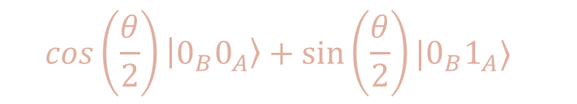

THE SPECIALIZED CIRCUIT FOR GENERATING WERNER STATES
HELD BY CHARLIE
$${|0⟩}_{A}$$
$$R_{y}(θ)$$
$H$
$${|0⟩}_{B}$$
+
$X$
$H$
$$0_{C}$$
$$C=1$$
$$C=0$$
$$C=1$$
$$C=0$$
$$\cos\left(\frac{θ}{2}\right)\left|0_{B}0_{A}\right\rangle +\sin\left(\frac{θ}{2}\right)|0_{B}1_{A}⟩$$
Measurement probabilities
$$P\left\{0_{A}\right\}=\cos^{2}\left(\frac{θ}{2}\right)$$
$$P\left\{1_{A}\right\}=\sin^{2}\left(\frac{θ}{2}\right)$$

Slide 9







In the ideal case, it is sufficient to put theta = 180° = \pi and the circuit simplifies to (after the measure of alice qubit)
$$P\left\{1_{A}\right\}=\sin^{2}\left(\frac{π}{2}\right)=1$$
$$P\left\{0_{A}\right\}=\cos^{2}\left(\frac{π}{2}\right)=0$$
$${|1⟩}_{A}$$
$H$
$$\left|ψ^{−}\right\rangle =\frac{\left|01\right\rangle −|10⟩}{\sqrt{2}}$$
$${|0⟩}_{B}$$
+
$X$

Slide 10

In the case of errors on the channel, they are simulated using the general circuit illustrated before using as theta values:
$$0≤θ<π$$
Noting that when theta = 0 at the output of the circuit there will be a completely depolarized state.

Slide 11









In the scenario where there is Eve that takes control of the site-generating entangled photon pairs and no more Charlie
$${|0⟩}_{A}$$
$${|0⟩}_{A}$$
$X$
$$|1_{B}0_{A}⟩$$
$$\frac{1}{2}$$
$$|0_{B}1_{A}⟩$$
$${|0⟩}_{B}$$
$X$
$${|0⟩}_{B}$$
PROBABILITY

Slide 12










In the scenario where there is Eve that takes control of the site-generating entangled photon pairs and no more Charlie
$${|0⟩}_{A}$$
$$\frac{1}{2}$$
$$|1_{B}0_{A}⟩$$
$${|0⟩}_{B}$$
$X$
PROBABILITY
$${|0⟩}_{A}$$
$X$
$$\frac{1}{2}$$
$$|0_{B}1_{A}⟩$$
$${|0⟩}_{B}$$

Slide 13
IDEAL CONDITIONS
RESULTS
ALL THE PLOTS required in the project specifications

Slide 14
METRICS TO EVALUATE
S e Rmis al variare di theta

Slide 15
CHANNEL ERRORS
EXPLAIN HOW THEY ARE INTRODUCED VIA THE SPECIALIZED CIRCUIT
ADD THE SCREEN OF THE CIRCUIT AND FORMULAS…
$$w⋅\left|ψ^{−}\right\rangle \left\langle ψ^{−}\right| + \frac{1−w}{4}⋅I$$
$$R_{mis}=\frac{\#mismatchedbits}{totalkeylength }$$

Slide 16
RESULTS WITH FOLLOWIN SETTING:
# Number of times the protocol is executed for each setting
n = 30
# Theta values to be used for the generation of the Werner States
theta_values = np.linspace(0, np.pi, 15)
# Whether Eve is eavesdropping or not
eavesdropping = False
# Number of EPR pairs to be generated in one execution of the protocol
epr_pairs = 300

Slide 17
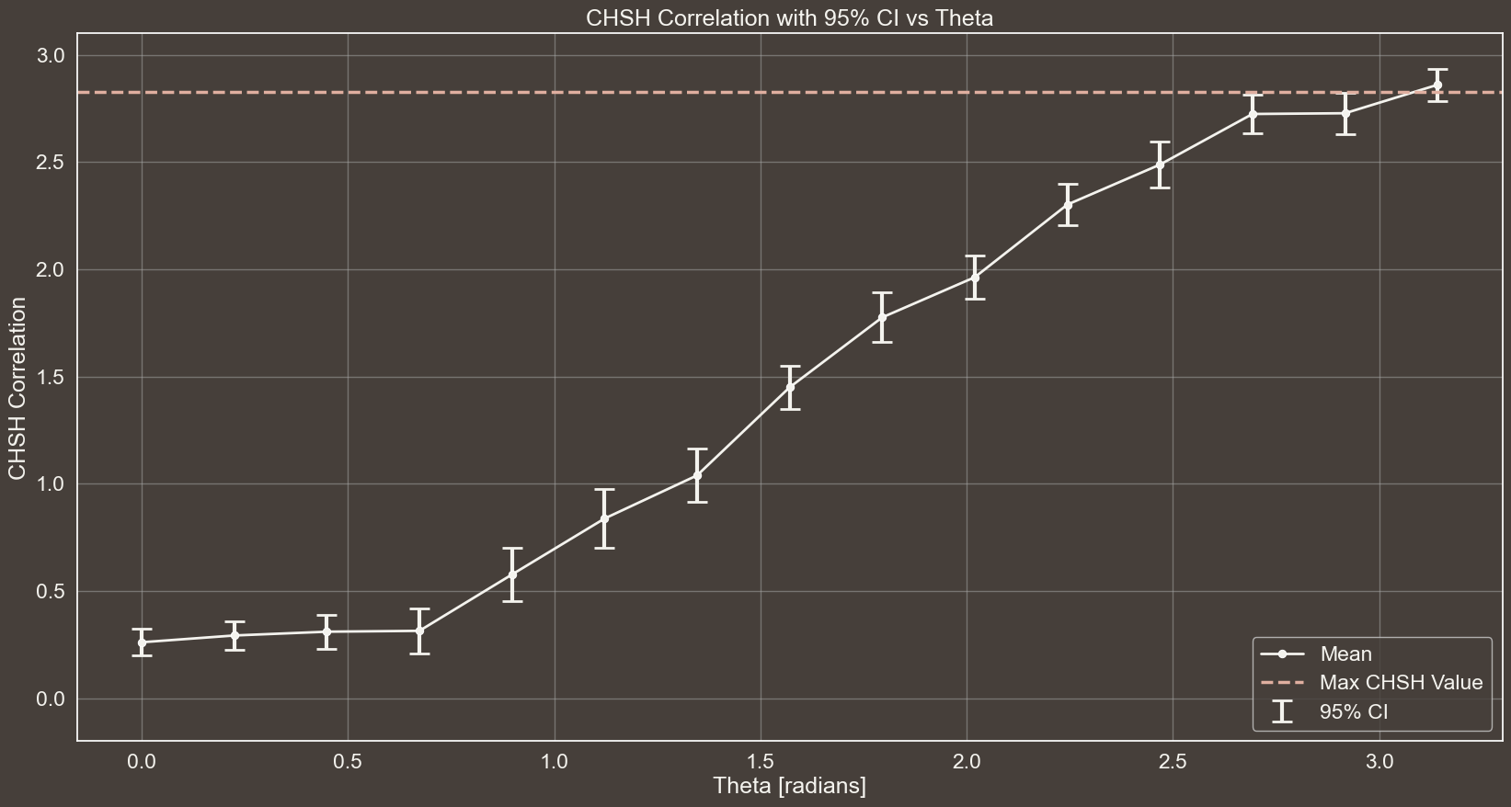
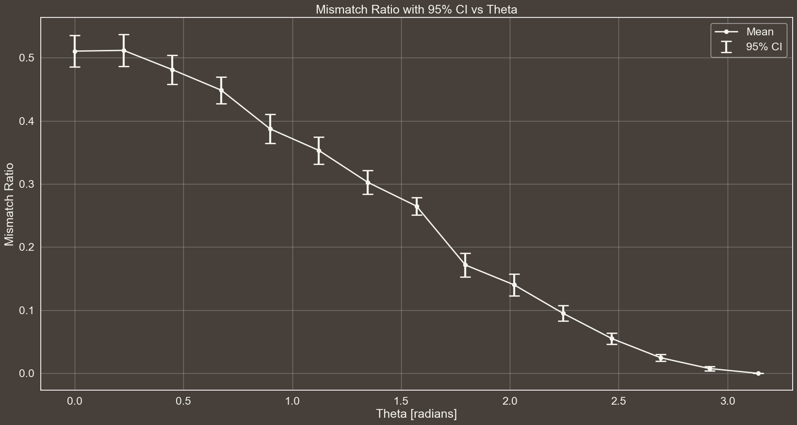

Slide 18
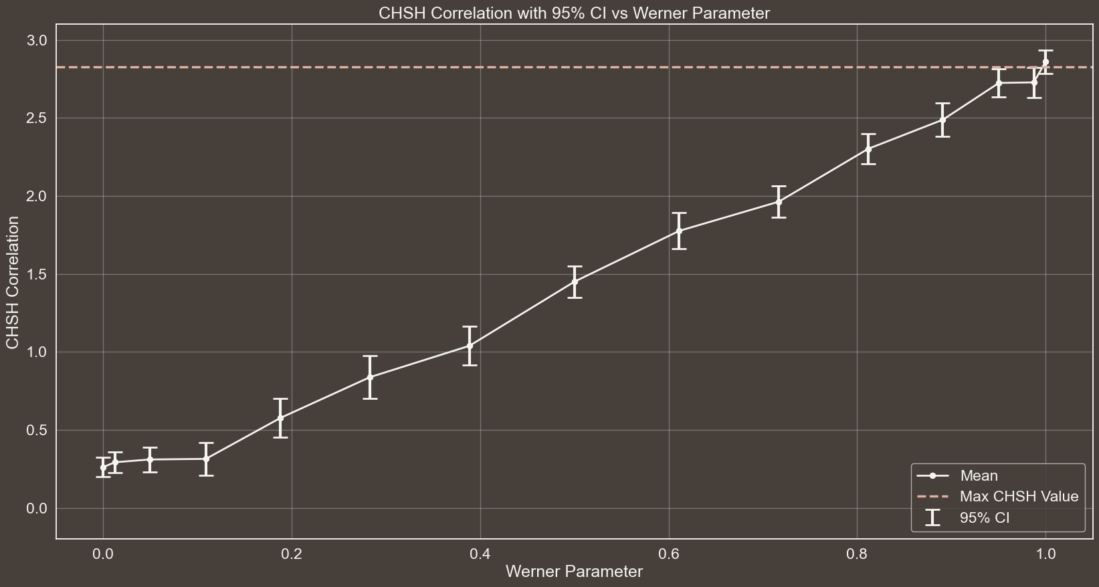
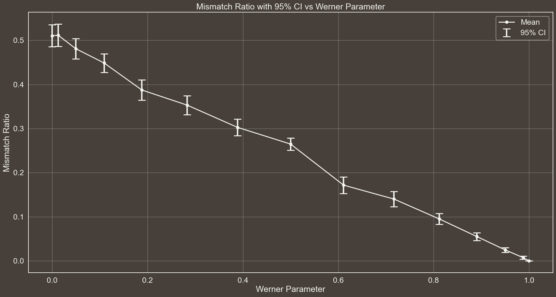

Slide 19
RESULTS WITH FOLLOWIN SETTING:
# Number of times the protocol is executed for each setting
n = 30
# Theta values to be used for the generation of the Werner States
theta_values = np.linspace(0, np.pi, 15)
# Whether Eve is eavesdropping or not
eavesdropping = False
# Number of EPR pairs to be generated in one execution of the protocol
epr_pairs = 1000

Slide 20
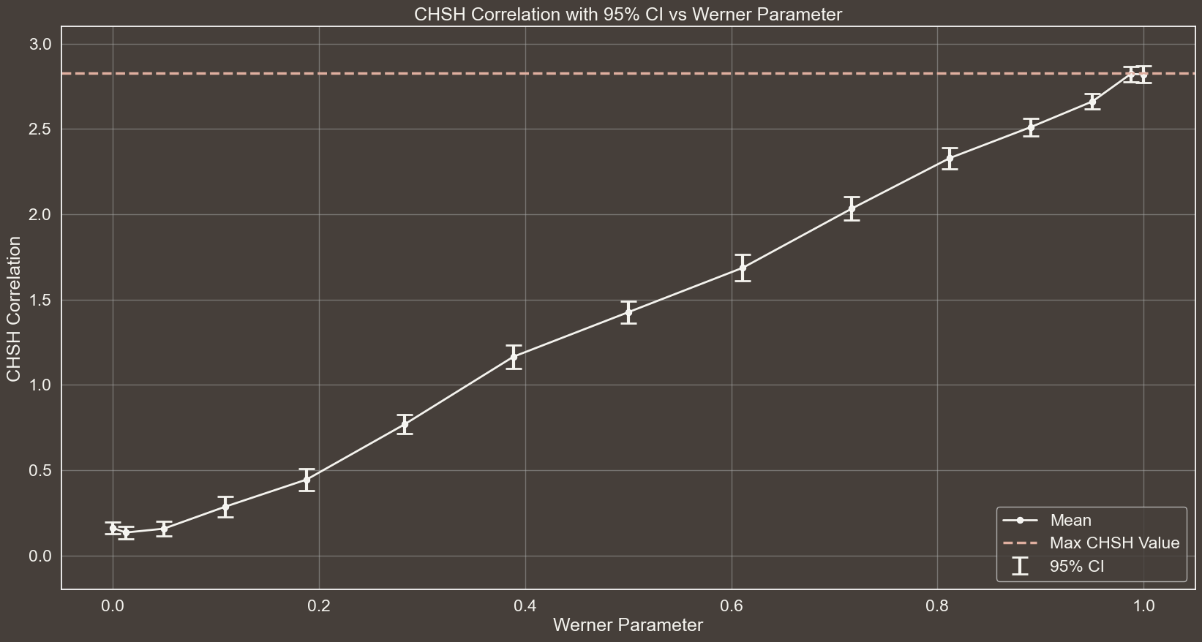
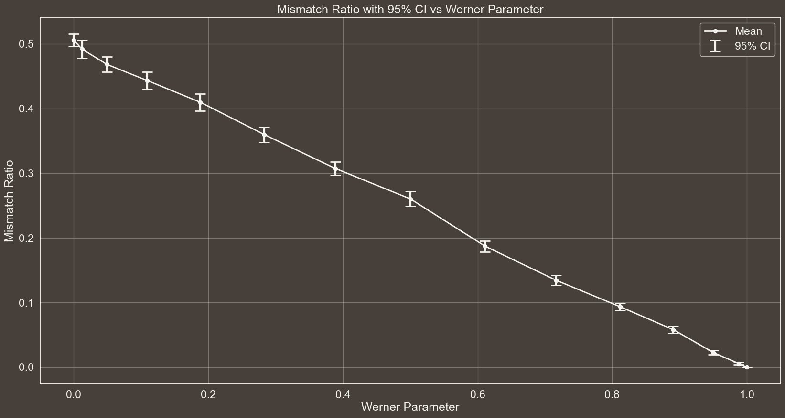

Slide 21
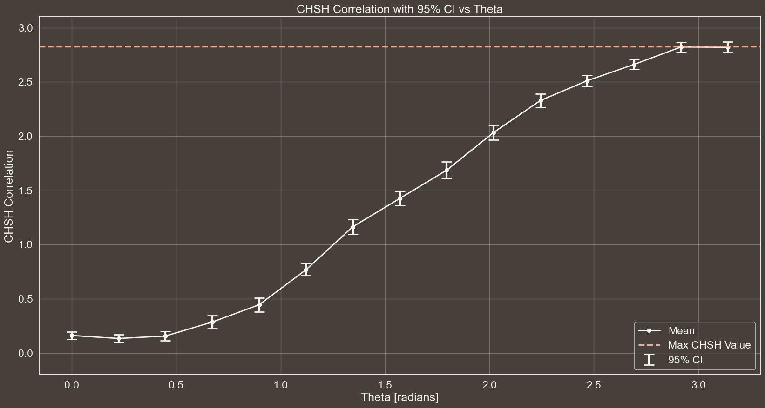
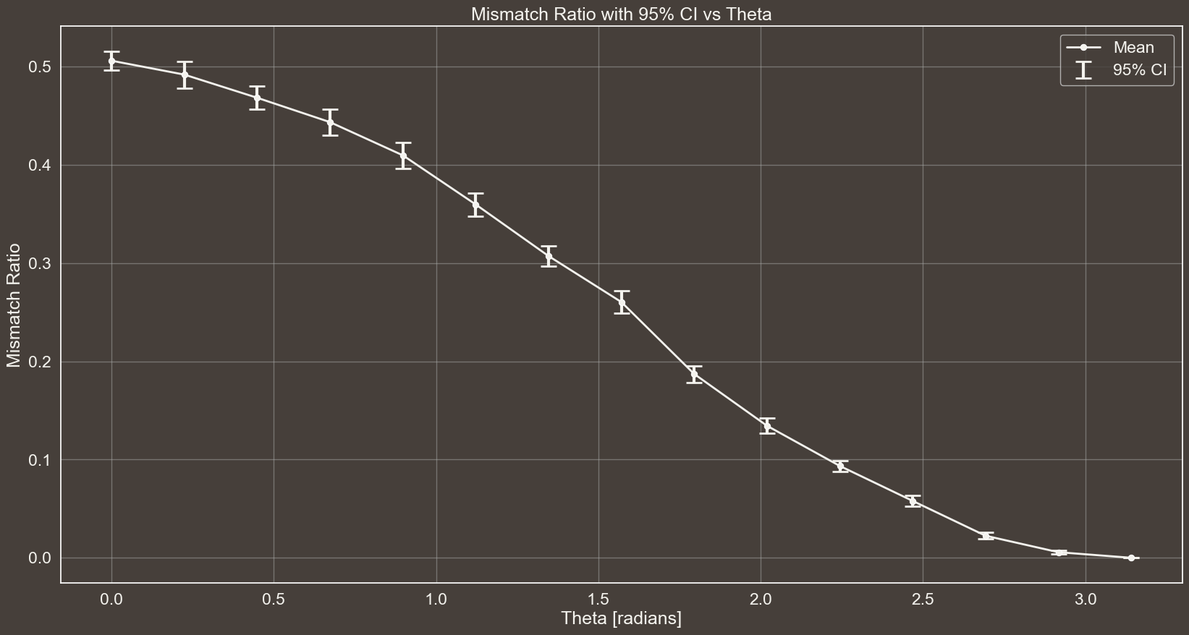

Slide 22
RESULTS WITH FOLLOWIN SETTING:
# Number of times the protocol is executed for each setting
n = 30
# Theta values to be used for the generation of the Werner States
theta_values = np.linspace(0, np.pi, 15)
# Whether Eve is eavesdropping or not
eavesdropping = False
# Number of EPR pairs to be generated in one execution of the protocol
epr_pairs = 80

Slide 23
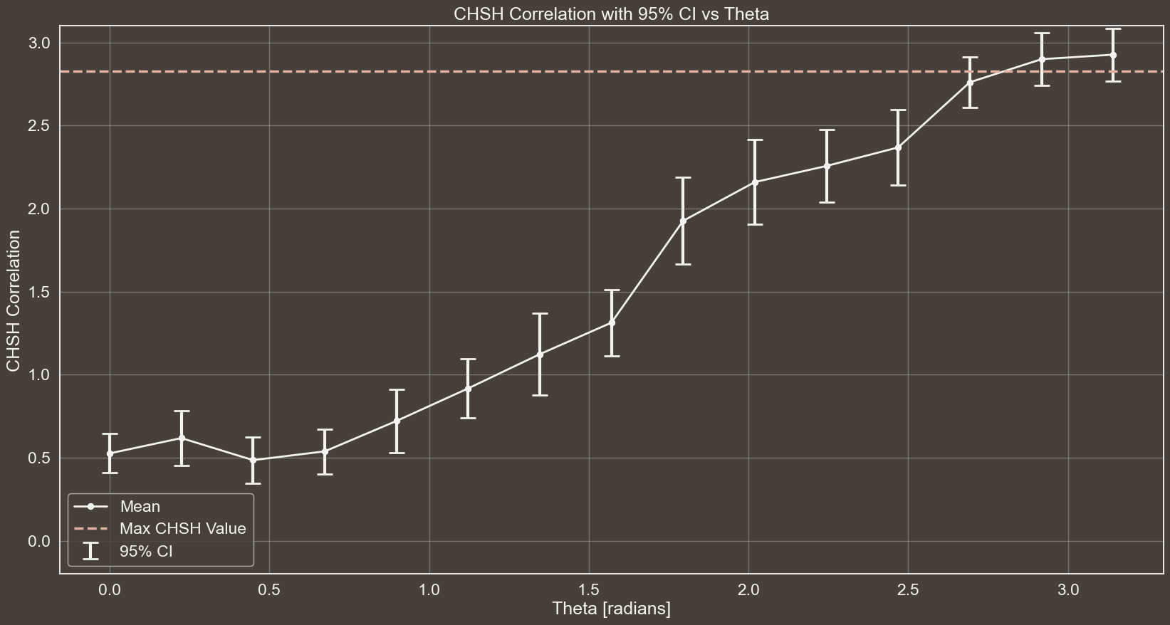
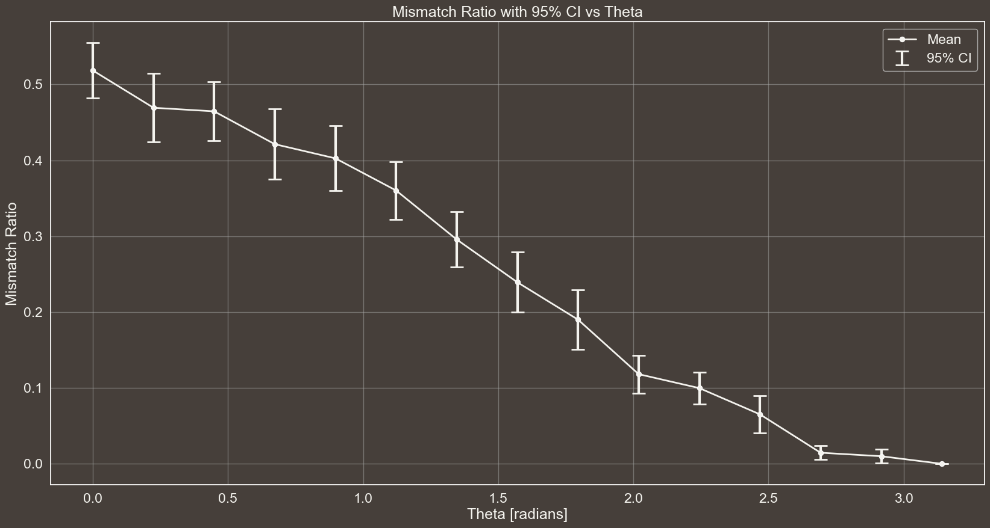

Slide 24
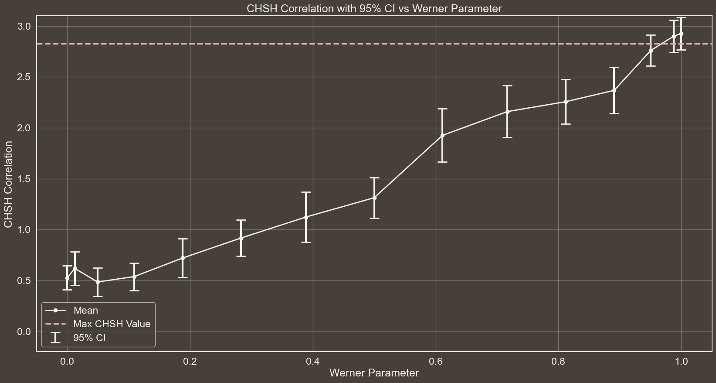
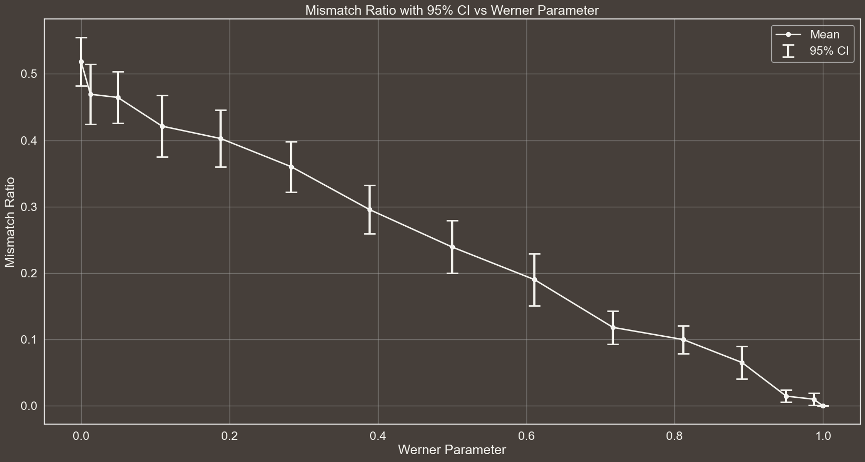

Slide 25
RESULTS WITH FOLLOWIN SETTING:
# Number of times the protocol is executed for each setting
n = 30
# Theta values to be used for the generation of the Werner States
theta_values = [np.pi] # np.linspace(0, np.pi, 15)
# Whether Eve is eavesdropping or not
eavesdropping = True
# Number of EPR pairs to be generated in one execution of the protocol
epr_pairs = 300

Slide 26
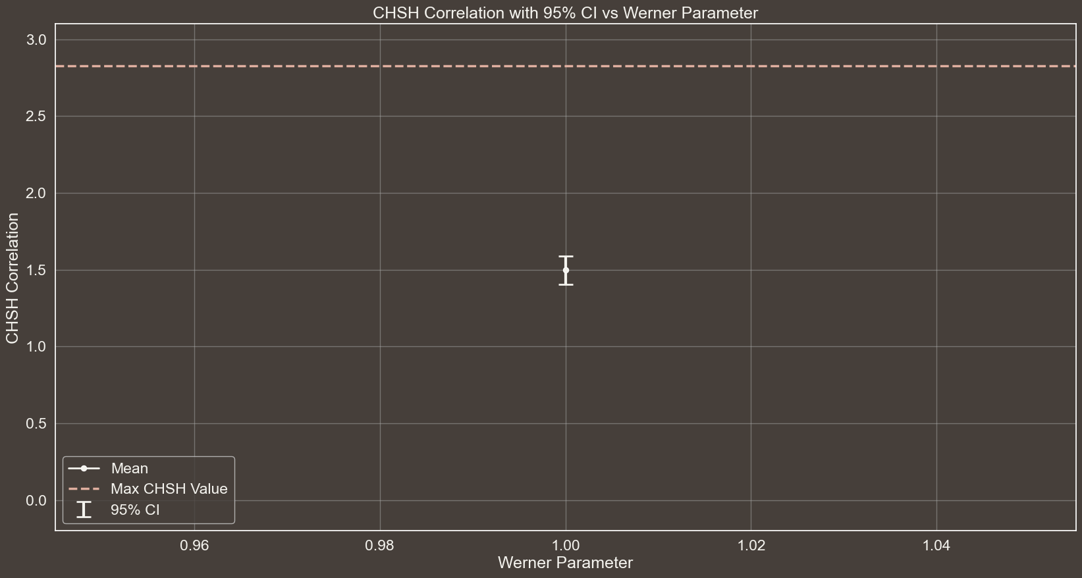
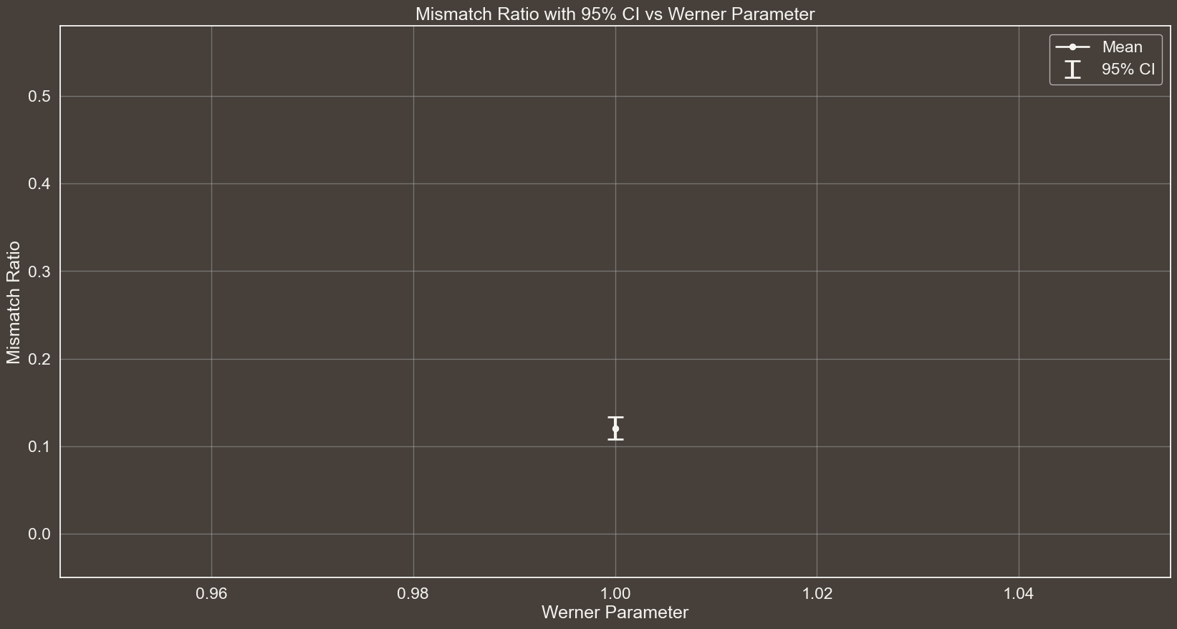
Spiegare a cosa sono dovuti gli errori in questo caso… Il fatto che se misuro in base W e ho 01 o 10 allora posso ottenere tutti gli outcome con diverse probabilità

Slide 27



EAVESDROPPING
GRAPH OF S WITH CI THAT IS BELOW 2sqrt(2)
$$\left|ψ^{−}\right\rangle →$$
$$|01⟩$$
$$\frac{1}{2}$$
$$|10⟩$$

Slide 28
REFERENCES
METTERE LIN KCHE CI SONO NELLE NOTES

Slide 29
THANKS
FOR YOUR ATTENTION

Slide 30

MASTER’S DEGREE IN COMPUTER ENGINEERING
INTELLIGENT SYSTEMS
PROJECT DISCUSSION
Comparative Analysis of Deep Learning Models for Brain Tumor Segmentation in MRI Images
PROFESSORS
STUDENT
PIETRO DUCANGE
FABRIZIO RUFFINI
GIOVANNI LIGATO
University of Pisa

Slide 31

Brain Tumors directly impair Brain function, affecting cognition, mood and personality.
Timely detection of these Tumors is crucial, as recognizing the initial stages of a Brain Tumor can profoundly influence a patient’s prognosis.
BACKGROUND
Reading and interpreting MRI scans is an intricate process. Indeed, it is estimated that in 5-10% of scans, a relevant Pathology is missed.
THE PROBLEM
Intelligent Systems to automatically identify and segment Regions Of Interest (ROI).
SOLUTION

Slide 32
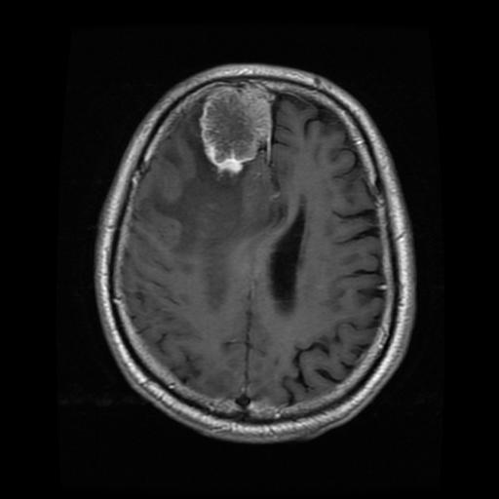


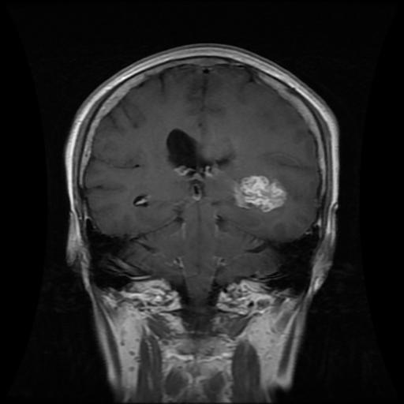


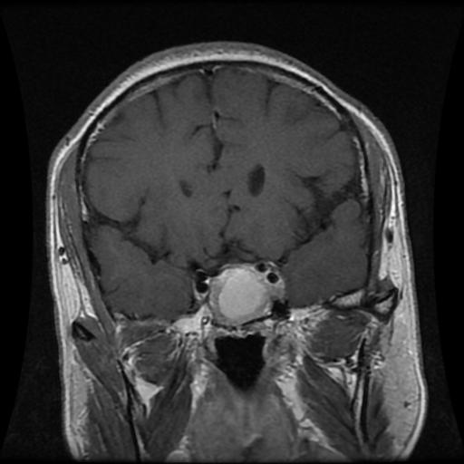


DATASET
MENINGIOMA
708
Collected from two Hospitals in China between 2005 and 2010.
GLIOMA
1426
233 Patients
PITUITARY
930
The Tumor regions were manually segmented by three experienced radiologists.

Slide 33


YOLOv8n-seg 3.4
YOLOv8s-seg 11.8
YOLOv8
YOLOv8m-seg 27.3
YOLOv8l-seg 46.0
YOLO
YOLOv8x-seg 71.8
DEEP LEARNING MODELS
YOLOv9c-seg 27.9
YOLOv9
YOLOv9e-seg 60.5
U-Net
1.94
Region Growing
0
CLASSICAL ALGORITHM
THIS COLOR SHOWS THE MODEL'S COMPLEXITY IN MILLIONS OF PARAMETERS

Slide 34
MAIN
.
2 | X ∩ Y |
EVALUATION
=
DICE SCORE
METRIC
| X | + | Y |
It measures the similarity between two samples and is used to compare algorithm outputs against reference masks, particularly in medical applications.

Slide 35




EXPERIMENTAL ANALYSIS
WORKFLOW
DATASET PREPARATION
TRAINING
RESULTS
5 FOLD CROSS-VALIDATION

Slide 36
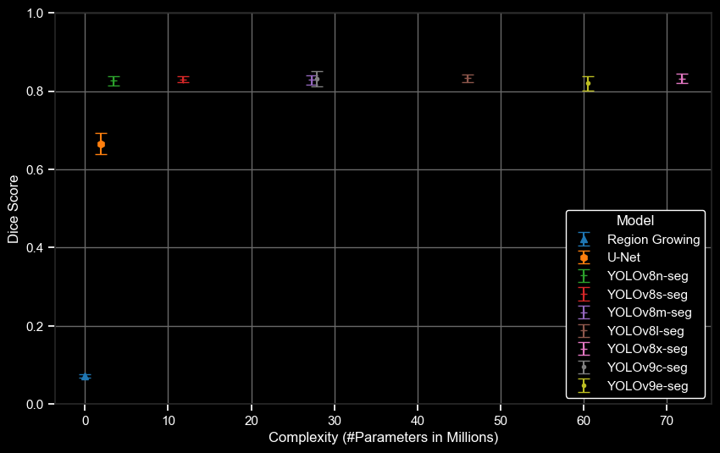
SEGMENTATION RESULTS
Dice Score
Complexity (#Parameters in Millions)

Slide 37
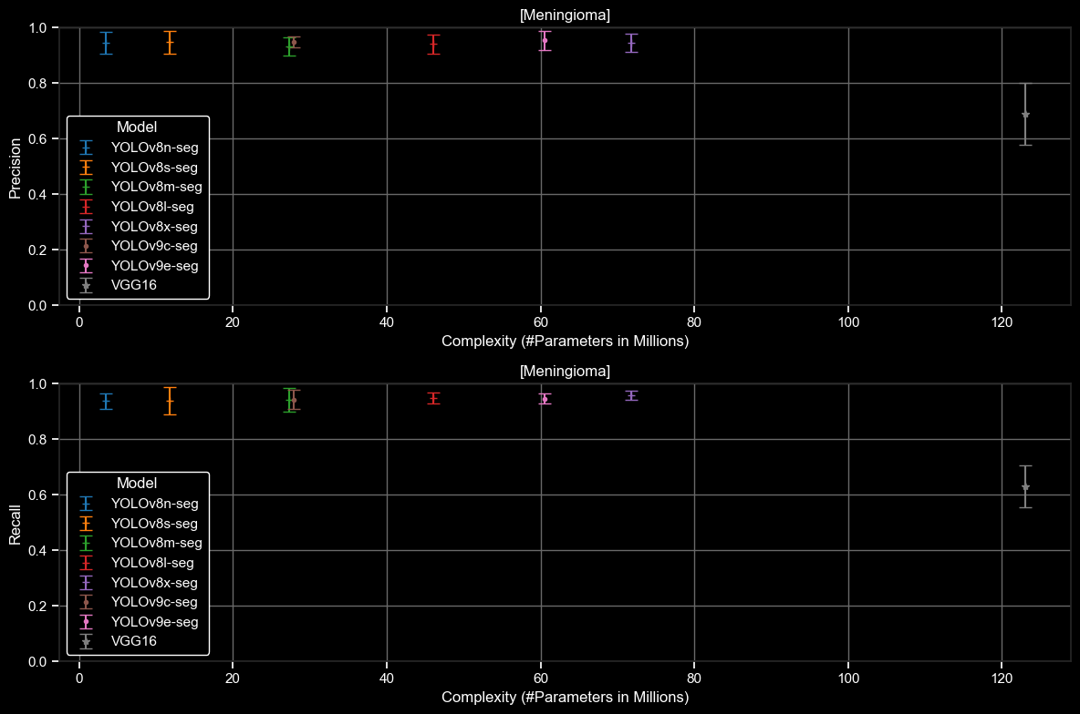
CLASSIFICATION RESULTS
MENINGIOMA

Slide 38
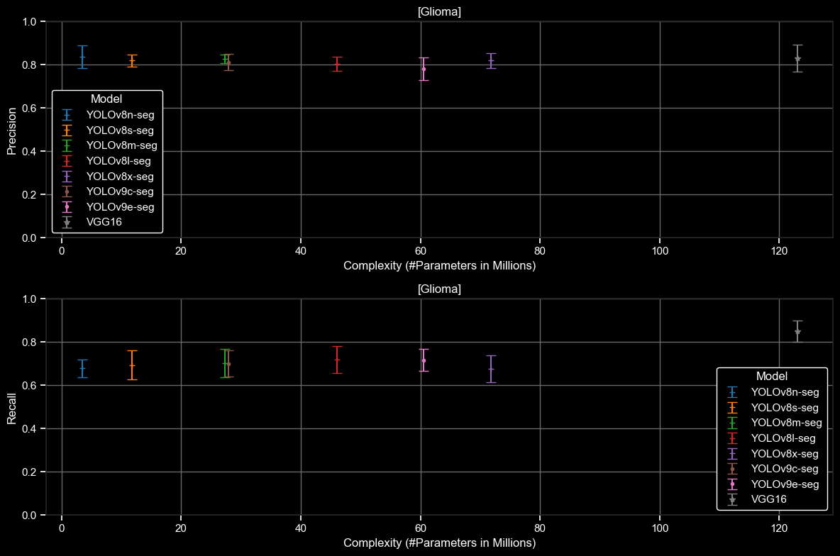
CLASSIFICATION RESULTS
GLIOMA

Slide 39
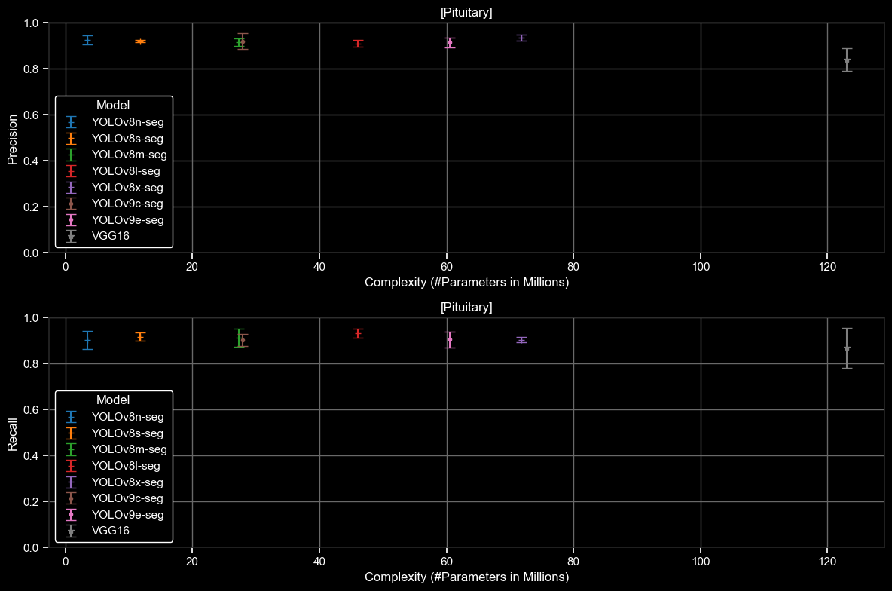
CLASSIFICATION RESULTS
PITUITARY

